Slide 1
Authority Control Rules
Yoel Kortick
Yoel.Kortick@clarivate.com

Slide 2
  Introduction
  The Authority Control Rules for Link BIB Headings
  The Authority Control Rules for Link BIB Headings – example 1
    Checks the words in the authority heading
  The Authority Control Rules for Link BIB Headings – example 2
    Checks the authority record ID of the authority heading
  The Authority Control Rules for Link BIB Headings – example 3
    Checks the diacritics in the heading
  The Authority Control Rules for Link BIB Headings – example 4
    Checks the subfield codes in the heading
  Authority Control – Exclude Heading from Linking
    adding $$9 no_linkage to the bibliographic heading
Agenda

Slide 3
Introduction

Slide 4
Introduction
Authority Control Rules allow institutions to determine:
  When bibliographic headings should be linked to authority records
  When linking should be skipped
In addition, Authority Control Rules provide greater control over:
  The preferred term correction process
  The results produced by preferred term correction
This presentation focuses exclusively on Linking Bibliographic Headings and does not cover the Preferred Term Correction process.
  The rules used for Preferred Term Correction follow the same principles as those used for Linking Bibliographic Headings.

Slide 5
Introduction
This presentation demonstrates the methodology behind Authority Control Rules through relevant, real-life examples.
Rather than providing a lengthy theoretical explanation, the focus is on showing how the rules work in practice.
For additional details, see Authority Control Rules on the Knowledge Portal.

Slide 6
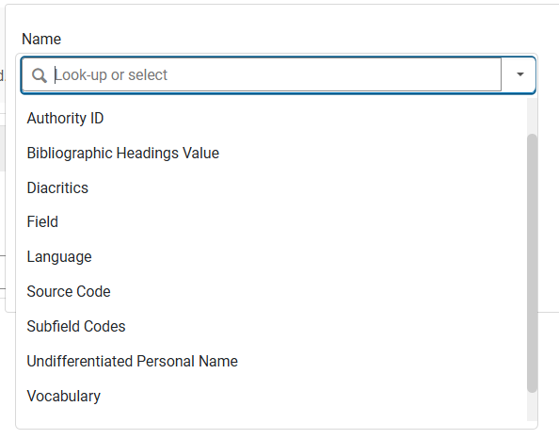
Introduction
The authority control rules can be based on the following parameters:

Slide 7
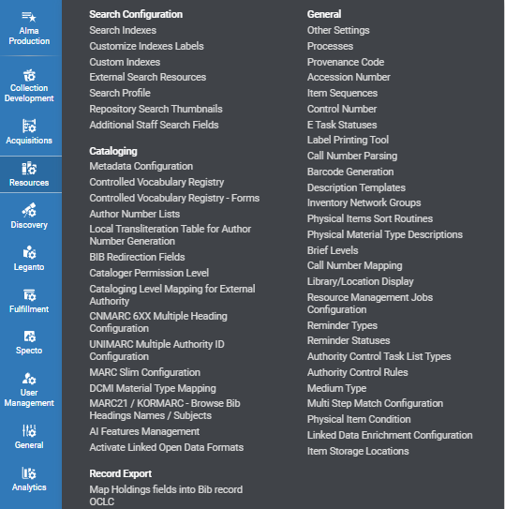
Introduction
The Authority Control Rules configuration page can be accessed at "Configuration > Resources > General > Authority Control Rules".

Slide 8
The Authority Control Rules for Link BIB Headings

Slide 9
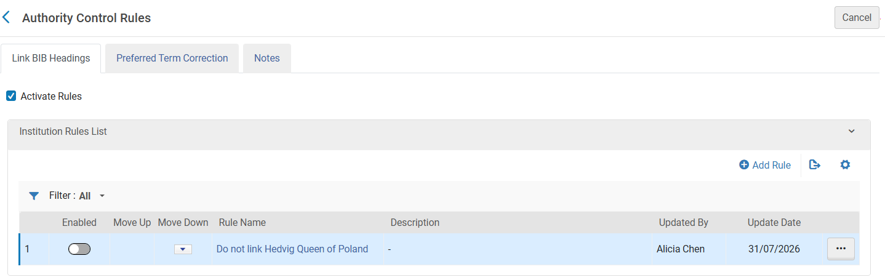
The Authority Control Rules for Link BIB Headings
This presentation focuses on the Authority Control Rules configured in the "Link BIB Headings" tab (Configuration > Resources > General > Authority Control Rules), which control the linking of bibliographic headings to authority records.

Slide 10
The Authority Control Rules for Link BIB Headings
The purpose of the Link BIB Headings rules is to allow institutions to control when Alma should link bibliographic headings to authority records and when linking should be skipped.
Alma evaluates these rules in two situations:
  When a bibliographic record is saved
  When the Link Bibliographic Headings job runs
The rules determine whether linking should occur for specific types of bibliographic headings.
These rules provide institutions with precise control over which bibliographic headings are linked automatically, and which are intentionally excluded from the linking process.

Slide 11
The Authority Control Rules for Link BIB Headings
These rules work the same way as other Alma rule-based configurations:
  Alma evaluates the rules from top to bottom
  When a heading matches a rule, Alma applies that rule
  After applying the first matching rule, Alma stops evaluating additional rules
  If no rule matches, Alma applies the default rule configured for the institution

Slide 12
The Authority Control Rules for Link BIB Headings
Each rule includes:
  A parameter to check (or multiple parameters)
  A Boolean operator, such as:
    Equals
    Contains
    In List
    Not Equals
    Not in List
  A decision that tells Alma whether linking should or should not occur

Slide 13
The Authority Control Rules for Link BIB Headings – example 1
(Checks the words in the authority heading)

Slide 14
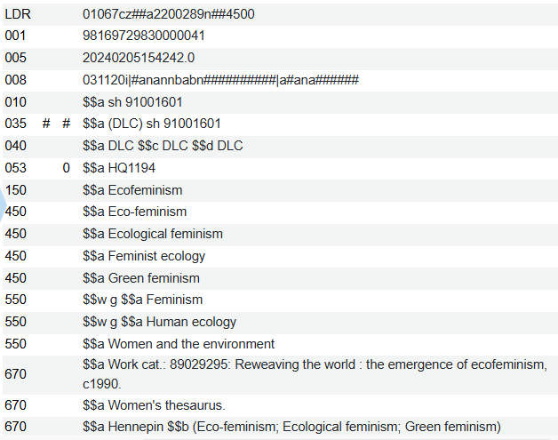
The Authority Control Rules for Link BIB Headings – example 1
Before creating the rule
Currently if a record is saved and a heading contains the word "ecology", and the heading exists in the Authority Vocabulary, then the heading will automatically be linked.
For example, on the next slide we will edit title "Ecofeminism : women, culture, nature" and add a 650_0 (LSCH heading) with value "$$a Feminist ecology". This is the non preferred term for "Ecofeminism" in LCSH record "sh 91001601".

Slide 15
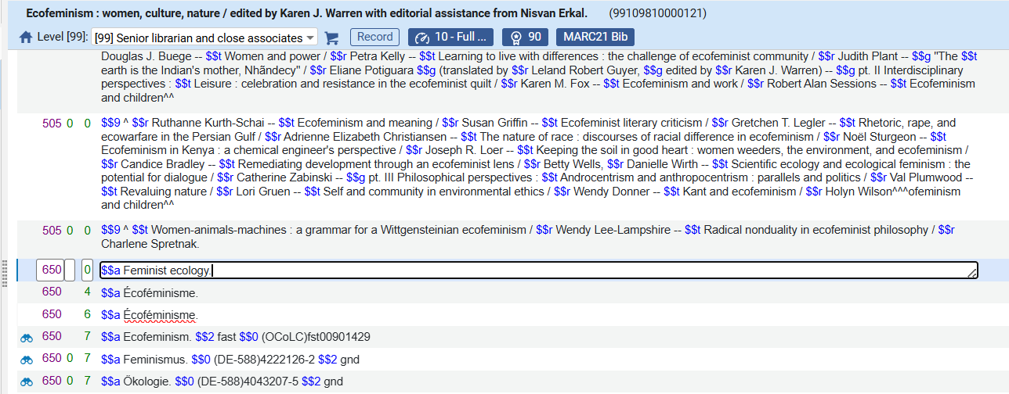
The Authority Control Rules for Link BIB Headings – example 1
Before creating the rule
We will now save this record
add a 650_0 (LSCH heading) with value "$$a Feminist ecology". This is the non preferred term for "Ecofeminism" in LCSH record "sh 91001601".

Slide 16
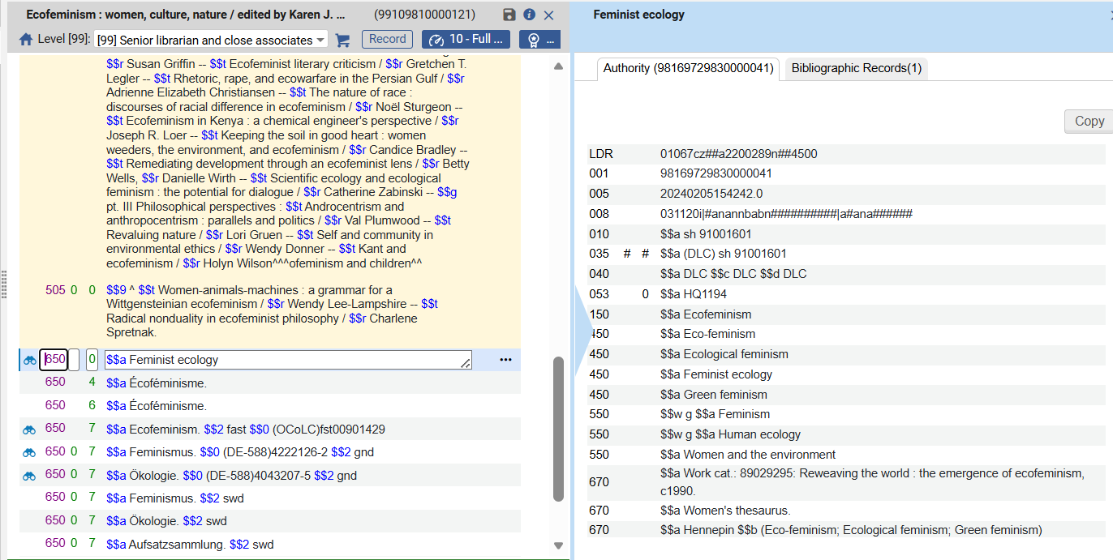
The Authority Control Rules for Link BIB Headings – example 1
Before creating the rule
The non preferred heading got linked to the authority record
The preferred term is "Ecofeminism"
It is linked

Slide 17
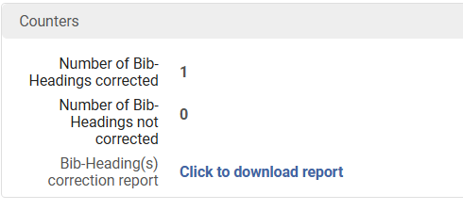
The Authority Control Rules for Link BIB Headings – example 1
Before creating the rule
When the "Authorities - Preferred Term Correction" job runs it changes the non-preferred term "Feminist ecology" to "Ecofeminism".
Here is the report from the job:

Slide 18
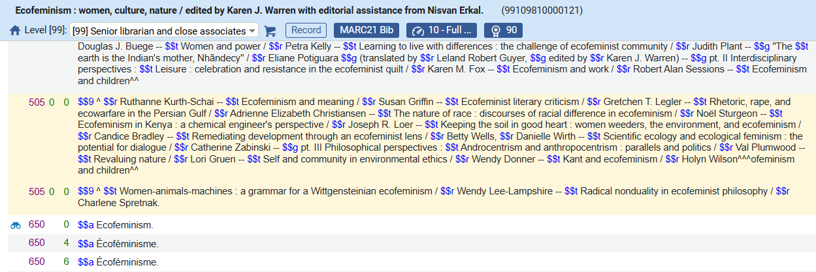
The Authority Control Rules for Link BIB Headings – example 1
Before creating the rule
Here we see that the change was made when the "Authorities - Preferred Term Correction" job ran.
The preferred term is "Ecofeminism"

Slide 19
The Authority Control Rules for Link BIB Headings – example 1
After creating the rule
Now the institution decides that any heading which contains the word "ecology" should not link to an authority heading. The staff user will do as follows:
  Access at the Authority Control Headings at "Configuration > Resources > General > Authority Control Rules".
  Remain in the default "Link BIB Headings" tab and ensure that "Activate "Rules" is checked.
  Create a rule as follows:
    Click "Add Rule"
    Give it a name, for example "not link headings with word ecology"
    Click "Add Parameter" and choose "Bibliographic Headings Value"
    Choose "Operator" "Contains"
    Enter value "ecology"

Slide 20
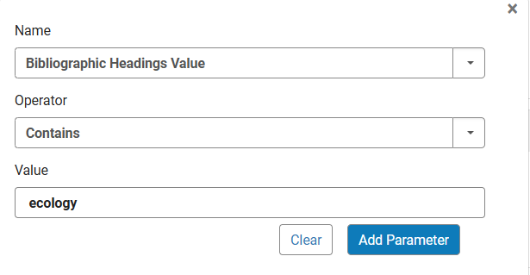
The Authority Control Rules for Link BIB Headings – example 1
After creating the rule
Here are the values we have chosen for the rule

Slide 21
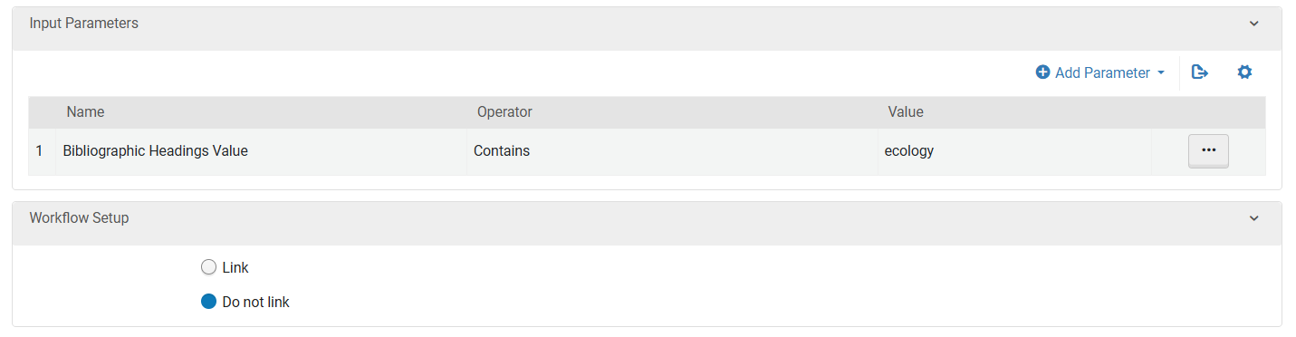
The Authority Control Rules for Link BIB Headings – example 1
After creating the rule
Here is the rule

Slide 22
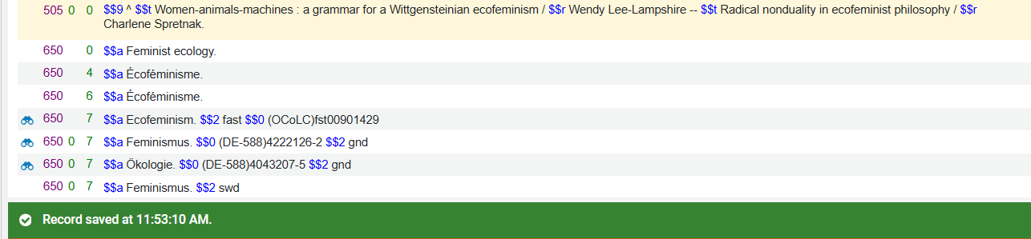
The Authority Control Rules for Link BIB Headings – example 1
After creating the rule
Now we test it. Again, we add non preferred term "Feminist ecology" to a 650_0 and save the record.
We have success.
This time the heading does not get linked because it meets the criteria of the rule which states "if it contains "ecology" do not link".
The 650_0 (LSCH heading) with value "$$a Feminist ecology" correctly did not link to in LCSH record "sh 91001601" with preferred term "Ecofeminism"
No link

Slide 23
The Authority Control Rules for Link BIB Headings – example 2
(Checks the authority record ID of the authority heading)

Slide 24
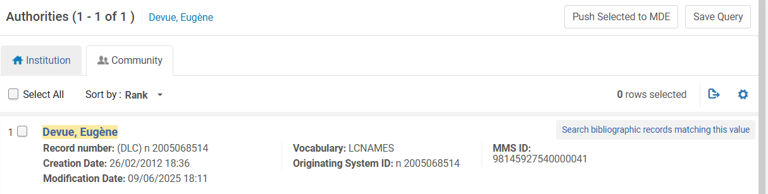
The Authority Control Rules for Link BIB Headings – example 2
Before creating the rule
Currently if a record is saved and it has heading "$$a Devue, Eugène" in a 100 or 70 field then it will link to LCNAMES authority record n 2005068514.
For example, on the next slide we will edit title "Academic library development and administration in Taipei" and add this Names heading.
Here is the authority record:

Slide 25
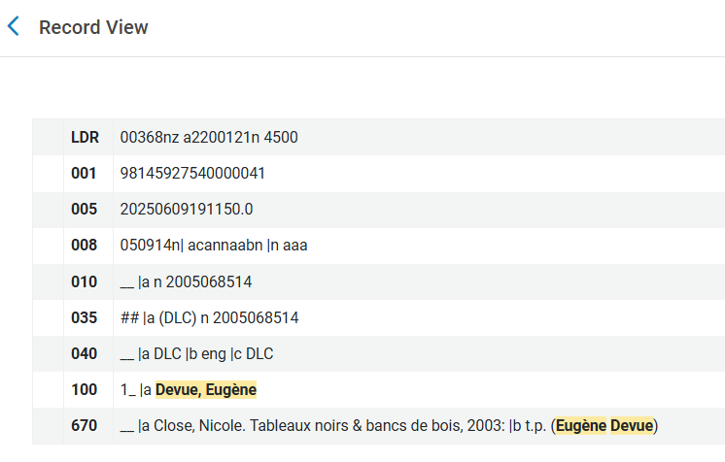
The Authority Control Rules for Link BIB Headings – example 2
Before creating the rule
Here we also see the ID of the authority record

Slide 26


The Authority Control Rules for Link BIB Headings – example 2
Before creating the rule
We will now save this bibliographic record:
After saving the record the heading is linked:

Slide 27
The Authority Control Rules for Link BIB Headings – example 2
After creating the rule
Now the institution decides that no headings should get linked to authority record n 2005068514 which we saw is for LCNAMES heading "Devue, Eugène"
For our purposes we will use the authority ID from the 035 subfield a of the authority record. It is n 2005068514.
We will state in the rule that "if the authority ID is n 2005068514 then do not link"

Slide 28
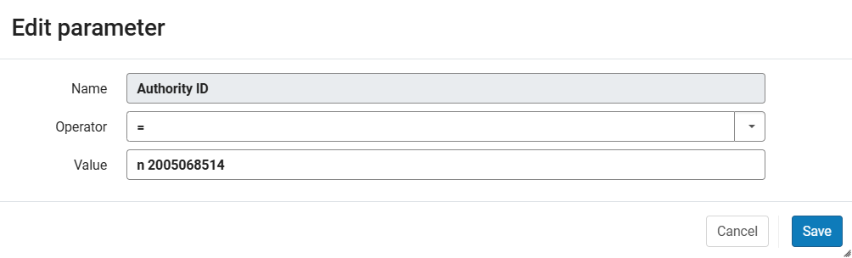
The Authority Control Rules for Link BIB Headings – example 2
After creating the rule
Here are the values we have chosen for the rule

Slide 29
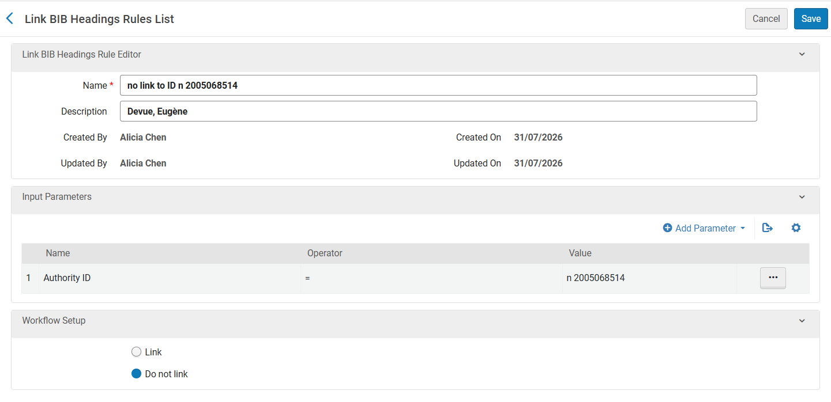
The Authority Control Rules for Link BIB Headings – example 2
After creating the rule
Here is the rule

Slide 30
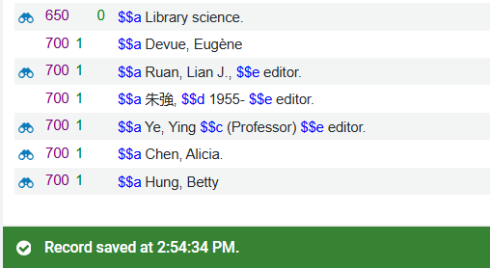
The Authority Control Rules for Link BIB Headings – example 2
After creating the rule
Now we test it. Again, we add term "$$a Devue, Eugène" to a 700 first indicator 1 and save the record.
We have success.
This time the heading does not get linked after saving the record.
The 7001 (LCNAMES heading) with value "$$a Devue, Eugène" correctly did not link to LCNAMES record "n 2005068514"

Slide 31
The Authority Control Rules for Link BIB Headings – example 3
(Checks the diacritics in the heading)

Slide 32
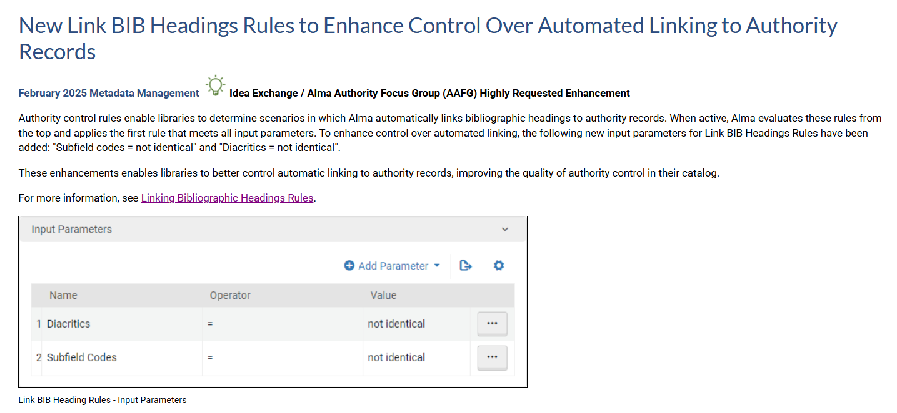
The Authority Control Rules for Link BIB Headings – example 3
We will now see the ability to take into account the diacritics of a heading.

Slide 33
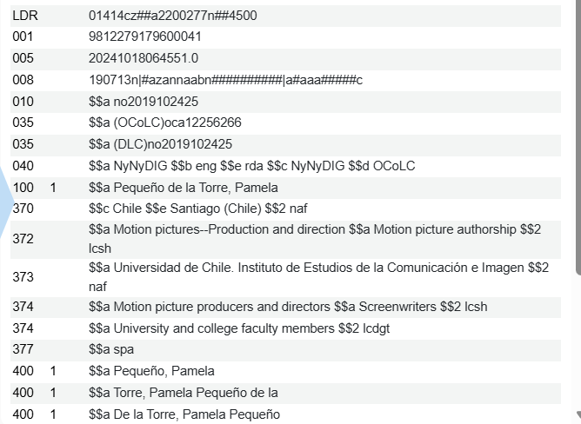
The Authority Control Rules for Link BIB Headings – example 3
Before creating the rule
The LCNAMES authority record for "Pequeño de la Torre, Pamela" includes the diacritic tilde (~) above the letter n, forming the character ñ.

Slide 34
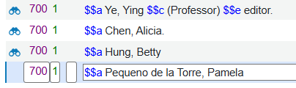
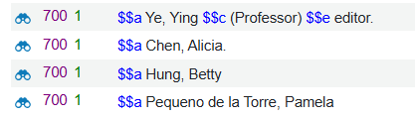
The Authority Control Rules for Link BIB Headings – example 3
Before creating the rule
If the cataloger catalogs this heading without the diacritics and saves the record:
The heading will in any case link (even without the diacritic)
No tilde above the n

Slide 35
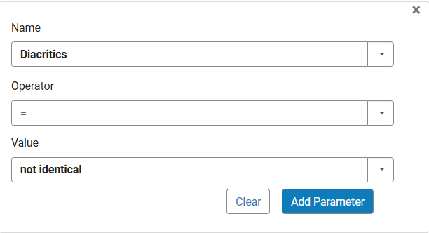
The Authority Control Rules for Link BIB Headings – example 3
Before creating the rule
However, the institution may wish to make an Authority Control Rule which states "if the diacritics of the bibliographic heading and authority heading are not the same then do not link".
Here is a rule which states that "the diacritics of the bibliographic heading and authority heading are not the same":

Slide 36
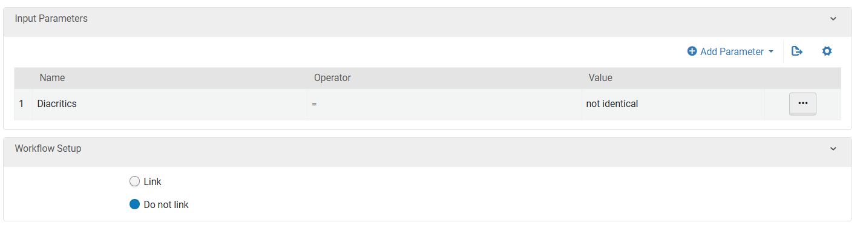
The Authority Control Rules for Link BIB Headings – example 3
After creating the rule
Here we have stated that when the diacritics of the bibliographic heading and authority heading are not the same do not link the heading

Slide 37
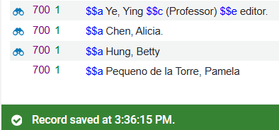
The Authority Control Rules for Link BIB Headings – example 3
After creating the rule
Now we test it. Again, we add term "$$a Pequeño de la Torre, Pamela" without the diacritic and save the record.
We have success.
This time the heading does not get linked after saving the record.
No tilde above the n
The 7001 (LCNAMES heading) with value "$$a Pequeno de la Torre, Pamela" correctly did not link to LCNAMES record because the diacritics are different than the authority heading
No link

Slide 38
The Authority Control Rules for Link BIB Headings – example 4
(Checks the subfield codes in the heading)

Slide 39
The Authority Control Rules for Link BIB Headings – example 3
We will now see the ability to take into account the diacritics of a heading.

Slide 40
The Authority Control Rules for Link BIB Headings – example 4
Before creating the rule
If we catalog either of these two texts in a 700 field, we get a full link to the authority record:
  $$a Shakespeare, William, $$d 1564-1616 $$t Tragedies
  $$a Shakespeare, William, $$d 1564-1616 $$x Tragedies
This is the case even though the heading in the authority record has this:
  $$a Shakespeare, William, $$d 1564-1616. $$t Tragedies

Slide 41
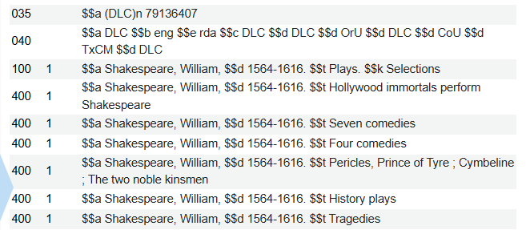
The Authority Control Rules for Link BIB Headings – example 4
Before creating the rule
The authority record has this:
  $$a Shakespeare, William, $$d 1564-1616. $$t Tragedies
The authority recoed does not have this:
  $$a Shakespeare, William, $$d 1564-1616 $$x Tragedies

Slide 42


The Authority Control Rules for Link BIB Headings – example 4
Before creating the rule
Here we can see that both versions work even though
  In the first case we have $$t tragedies (like the authority record)
  In the second case we have $$x tragedies (not like the authority record)
Full link to authority heading
Full link to authority heading

Slide 43
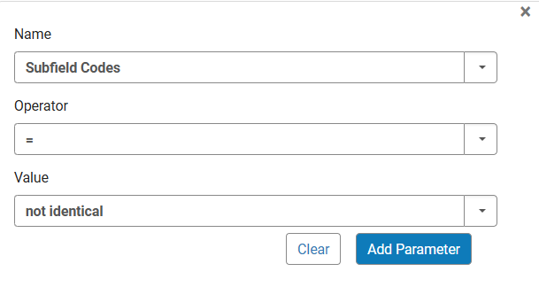
The Authority Control Rules for Link BIB Headings – example 4
Before creating the rule
However, the institution may wish to make an Authority Control Rule which states "if the subfield codes of the bibliographic heading and authority heading are not the same then do not link".
Here is a rule which states that "the subfield codes of the bibliographic heading and authority heading are not the same":

Slide 44
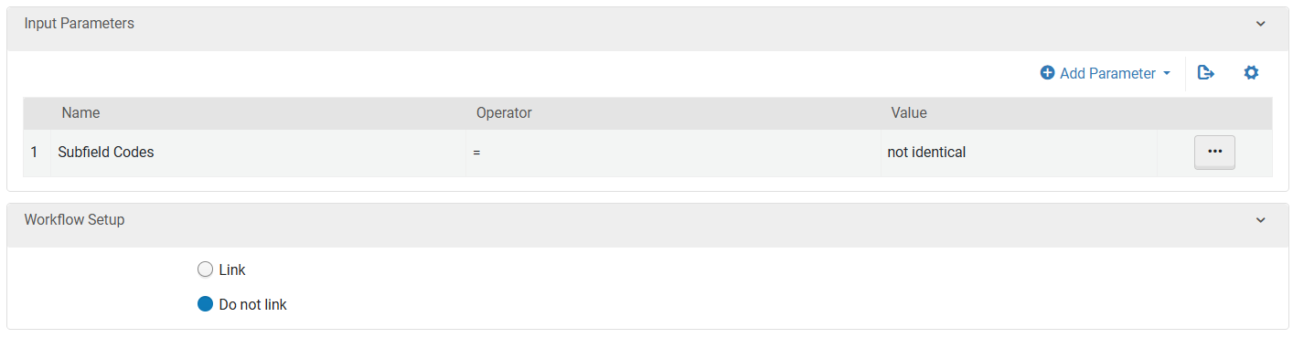
The Authority Control Rules for Link BIB Headings – example 4
After creating the rule
Here we have stated that when the subfield codes of the bibliographic heading and authority heading are not the same do not link the heading

Slide 45


The Authority Control Rules for Link BIB Headings – example 4
After creating the rule
Now we test it. We have success.
This time the heading which does not have the same subfield codes as the authority record does not get a full link to the authority record.
It still links because the subfields a and d are identical, and this it has a partial link instead of a full link.
Full link to authority record when all subfields of bibliographic heading are the same as in the authority heading
Full link to authority heading
Partial link to authority record when all subfields of bibliographic heading are not the same as in the authority heading
Partial link to authority heading

Slide 46
Authority Control – Exclude Heading from Linking

Slide 47
Authority Control – Exclude Heading from Linking
In addition to Authority Control Rules, Alma provides a direct method to prevent a bibliographic heading from linking to an authority record: Add subfield 9 with the value no_linkage to the bibliographic heading:
  The heading will not be linked to any authority record.
  This behavior is absolute and always takes precedence.

Slide 48
Authority Control – Exclude Heading from Linking
The "Add subfield 9 with the value no_linkage" method differs from Authority Control Rules, which work according to conditions.
  Authority Control Rules work according to conditions such as word from heading, diacritics in the heading, subfields in the heading, the authority ID in the authority record, and more.
  The "Add subfield 9 with the value no_linkage" method is a hard-coded exclusion. It prevents authority linking regardless of any rule configuration. No rule evaluation is performed.
Key Difference:
  The "Add subfield 9 with the value no_linkage" method is a permanent override
  Authority Control Rules make linking decisions based on configured conditions.

Slide 49
Authority Control – Exclude Heading from Linking
We will now look at this functionality using a live example.
First, we will catalog a bibliographic heading and not use the "Add subfield 9 with the value no_linkage" method
  The bibliographic heading will link to an authority record
Next, we will catalog a bibliographic heading and use the "Add subfield 9 with the value no_linkage" method
  The bibliographic heading will not link to an authority record

Slide 50
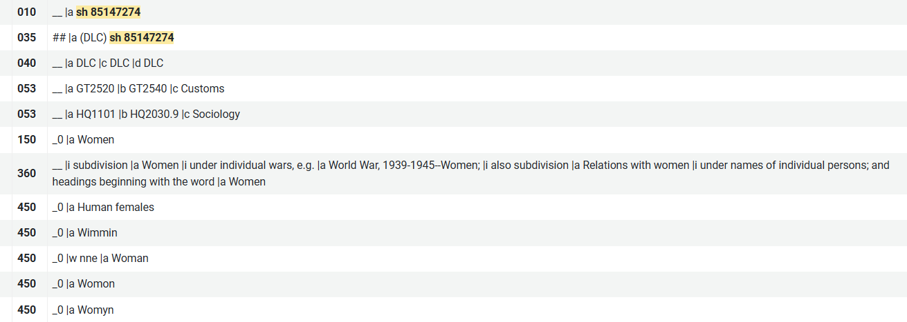
Authority Control – Exclude Heading from Linking
For example, LCSH authority record ID "sh 85147274" has preferred term "Women" and non preferred term "Human females".

Slide 51
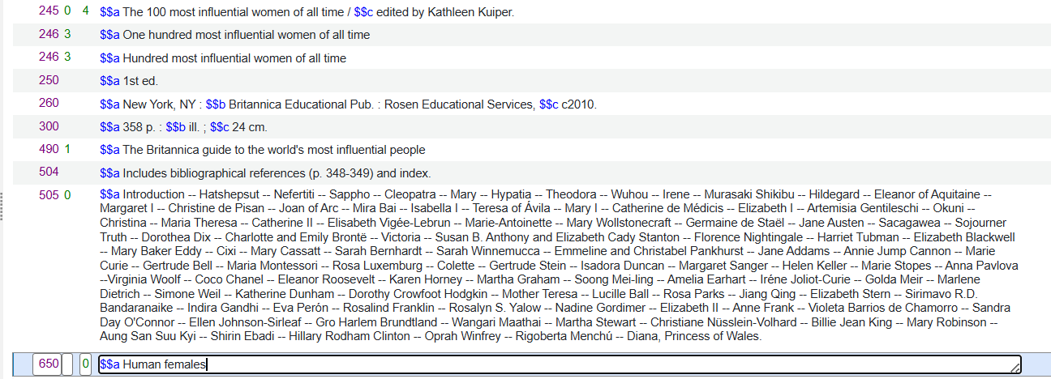
Authority Control – Exclude Heading from Linking
We will update title "The 100 most influential women of all time" and add a 650_0 field with text "$$a Human females" and save the record.
Example not using the "Add subfield 9 with the value no_linkage" method

Slide 52
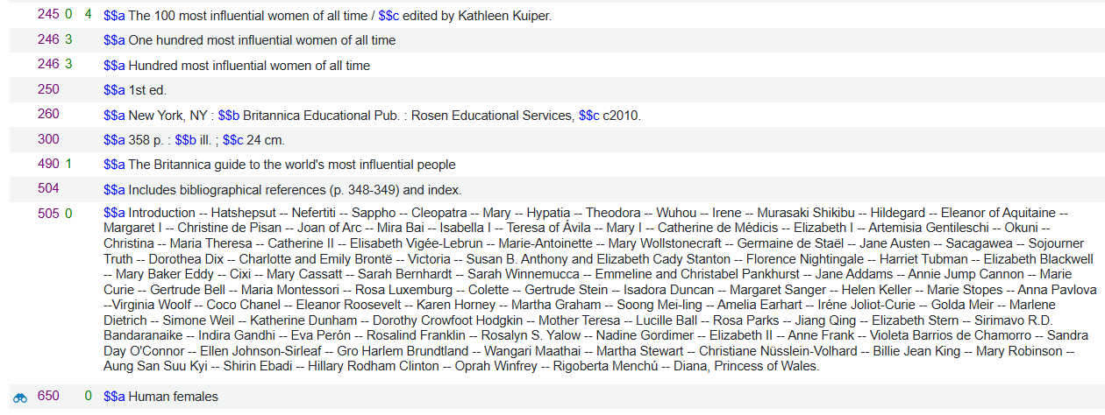
Authority Control – Exclude Heading from Linking
After saving the record the bibliographic heading links to the authority heading
Example not using the "Add subfield 9 with the value no_linkage" method
Indication that the bibliographic heading is linked to an authority heading

Slide 53
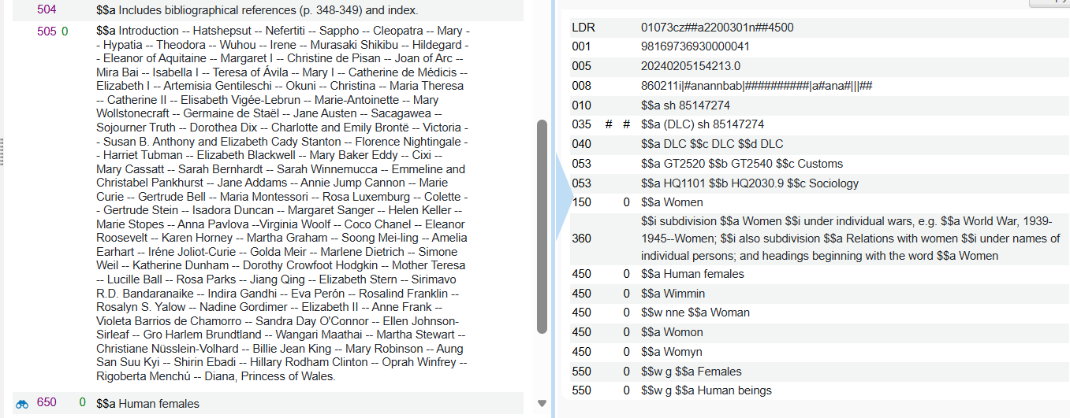
Authority Control – Exclude Heading from Linking
Here also we see that the bibliographic heading links to the authority heading
Example not using the "Add subfield 9 with the value no_linkage" method
Indication that the bibliographic heading is linked to an authority heading

Slide 54
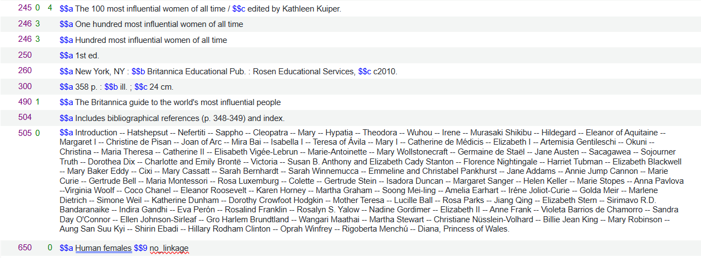
Authority Control – Exclude Heading from Linking
Now we will update title "The 100 most influential women of all time" and add a 650_0 field with text "$$a Human females $$9 no_linkage" and save the record.
Example using the "Add subfield 9 with the value no_linkage" method

Slide 55
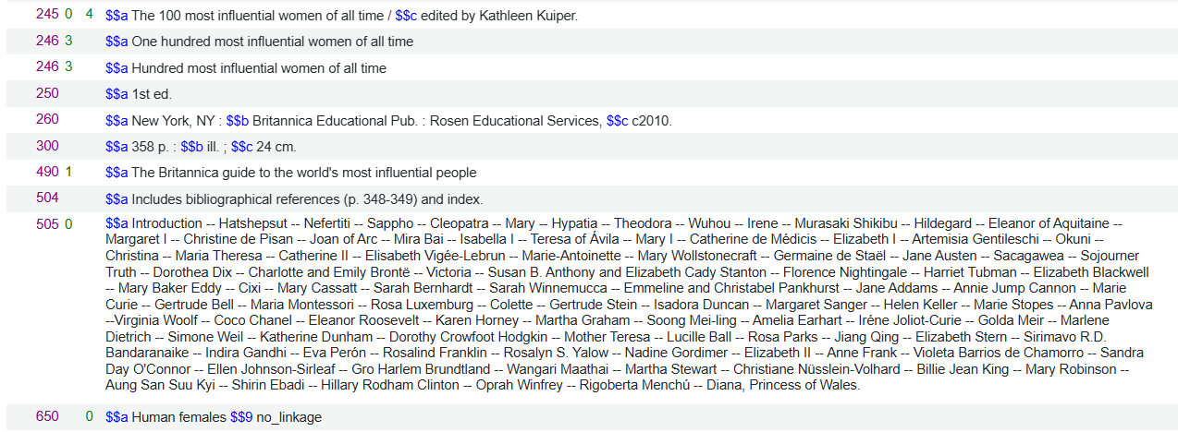
Authority Control – Exclude Heading from Linking
After saving the record the bibliographic heading does not link to the authority heading. This is because of the presence of $$9 no_linkage"
Example using the "Add subfield 9 with the value no_linkage" method
No indication that the bibliographic heading is linked to an authority heading

Slide 56

Yoel Kortick
Yoel.Kortick@clarivate.com
About Clarivate
Clarivate is a leading global provider of transformative intelligence. We offer enriched data,
insights & analytics, workflow solutions and expert services in the areas of Academia & Government, Intellectual Property and Life Sciences & Healthcare. For more information, please visit clarivate.com.
© 2026 Clarivate. All rights reserved
Clarivate and its logo, as well as all other trademarks used herein are trademarks of their respective owners and used under license.

